Slide 1
Collecting and storing data from Internet-based sources
Workshop :
Collecting and Storing Data from Internet-Based Sources
09 May 2017
Peter Smyth
UK Data Service

Slide 2
Overview of this workshop
Getting data from the Internet using APIs or file downloads
Accumulating data in a database for later use
Automating the processes on Windows and Linux
Notes:
Leave this for Peter

Slide 3
Automating processes
You can run your data collection manually
At the keyboard every morning a 9:00am
You do get instant feedback on errors
But several time day and night?
Not very convenient
Both Windows and Linux provide methods to automate the running of jobs
The machine has to be powered up
But you don’t necessarily need to be logged on

Slide 4
Automation - Windows
The automation system in Windows is called Task Scheduler
Windows makes extensive internal use of the Task Scheduler
But it is also available to the end user (providing appropriate permissions are set)
It has a GUI interface

Slide 5
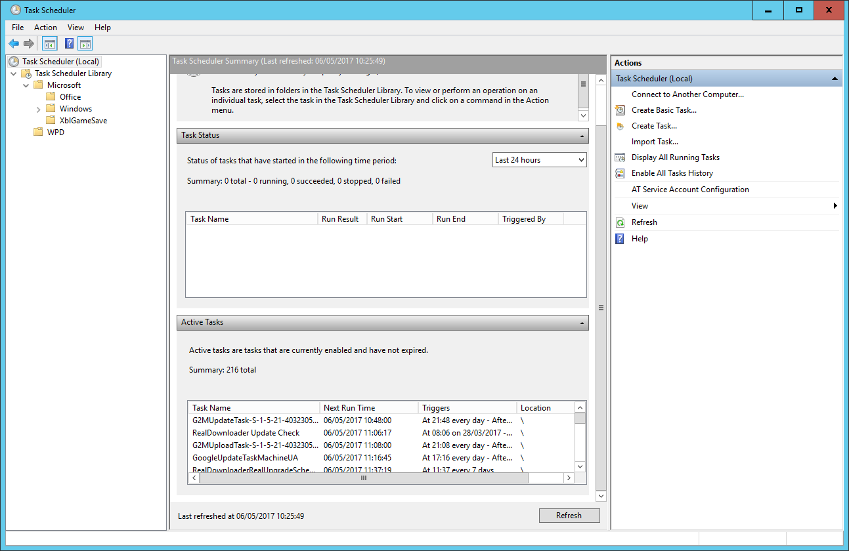
Automation - Windows
Task Scheduler GUI

Slide 6
Automation - Windows
The left-hand pane is a directory tree of folders
You can create your own folders
The centre section provides information on the item currently selected
In this Windows 10 system there are currently 216 active tasks
Installed applications may add tasks to regularly check for updates.
The right-hand pane provides a list of commands
We want to create a new task

Slide 7
Automation - Windows
Demonstration
Have a notepad file open everytime the user logs in
Steps:
Create a notepad file called Log.txt on the desktop and write .LOG into the first line and save it.
Open Task Scheduler
Create a folder under the Windows folder with your name and select it
Create a new task to open the Log.txt file everytime you log in

Slide 8
Automation - Linux
In a Linux system the automation process is known as CRON
Details of the tasks to be run are in a file called the crontab.
There is a systemwide crontab, but each user can make use of their own personal crontab
The formatting of the lines in the crontab is critical
You edit the crontab file with the command:
crontab –e
This either opens the existing crontab or creates a new one

Slide 9

Automation - Linux
The crontab file is opened in your choice of editor

Slide 10
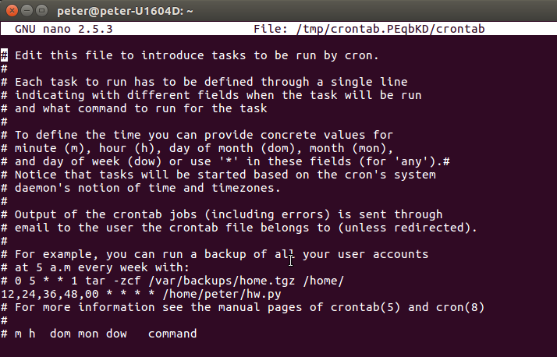
Automation - Linux
The default crontab file includes instructions as to how to complete a line
Only the highlighted line has been added

Slide 11
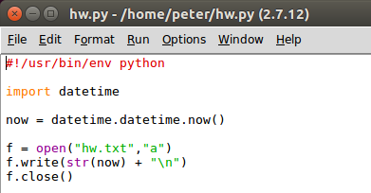
Automation - Linux
The line indicates that the program hw.py in the folder /home/peter should be run at 00,12, 24, 36 and 48 minute of every hour of every day – forever!
The program hw.py is very simple – writing a timestamp string to the file hw.txt

Slide 12
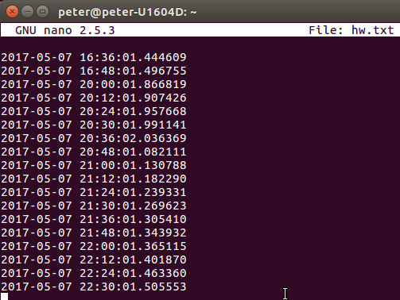
Automation - Linux

Slide 13
Automation - summary
Automation is useful for any kind of timed event which s repetitive on a known schedule.
It can be used to accumulate data from sources where the available data changes on a regular basis
Stock market
Weather
Tweets
You can construct simple workflows with one automated task being dependent an another
E.g one task selects a trending search term in twitter daily and another collects tweets based on that at hourly intervals

